Slide 1
Basic Electrical and Electronics Engineering
LECTURE 3.5
Dr. Sonam Shrivastava/ Assistant Professor (Sr.) /SELECT

Slide 2
BEEE102L
Basic Electrical and Electronics Engineering
DC Circuits
AC Circuits
Magnetic Circuits
Electrical Machines
Semiconductor Devices and Applications
Digital Systems

Slide 3
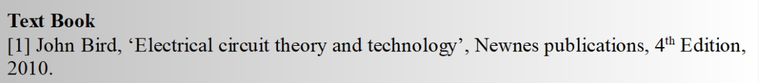
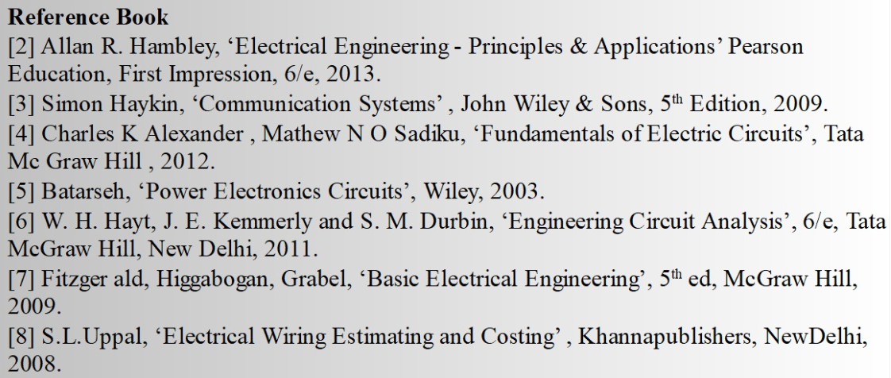
Books

Slide 4
Module 3. Magnetic Circuits
Electromagnetic Induction: Self And Mutual
Magnetically Coupled Circuits
Series and Parallel Magnetic Circuits
Dot Convention

Slide 5


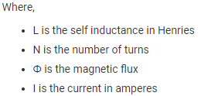
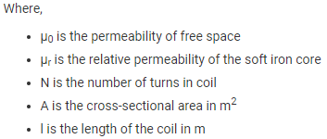
Self Inductance Mutual Inductance

Slide 6
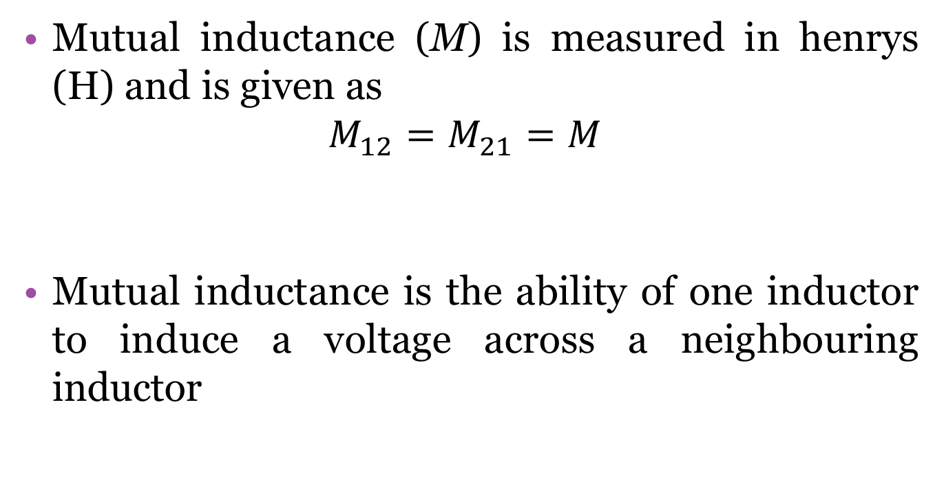
Mutual inductance
Mutual inductance (M) is measured in henrys (H) and is given as
$$M_{12}=M_{21}=M$$
Mutual inductance is the ability of one inductor to induce a voltage across a neighbouring inductor

Slide 7
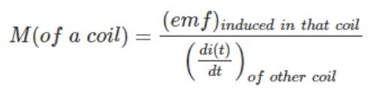
Mutual inductance
Mutual Inductance is the ratio between induced emf across a coil to the rate of change of current of another adjacent coil in such a way that two coils are in possibility of flux linkage.

Slide 8
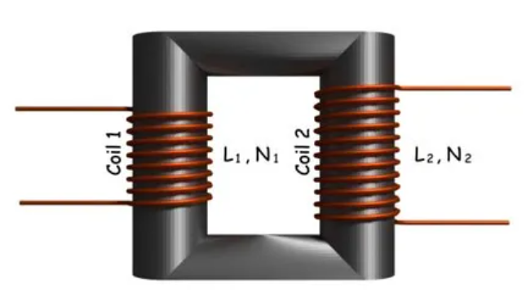
Mutual inductance
Let us two coils with self inductance L1 and L2.
Consider that there is a low reluctance magnetic core which couples these both coils in such a way that entire flux created by one coil will link the other coil. That means there will be no leakage of flux in the system.

Slide 9
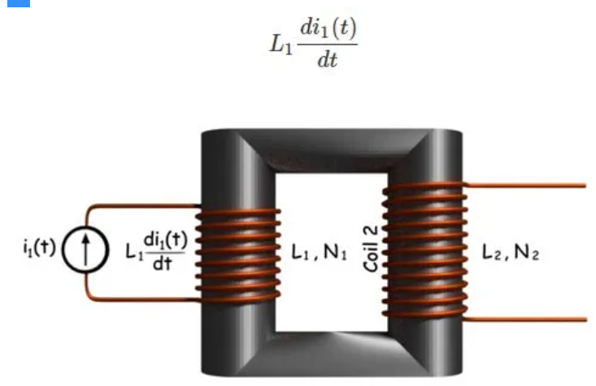
Mutual inductance
Apply a time varying current at coil 1 keeping the coil 2 open circuited. The voltage induced across the coil 1 will be

Slide 10
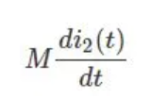
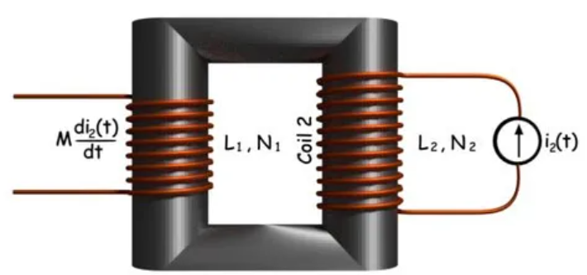
Mutual inductance
Now we will keep the first coil open and apply time varying current in coil 2.
The flux produced by coil 2 will link coil 1 through the magnetic core and as a result, the emf induced in the coil 1 will be

Slide 11
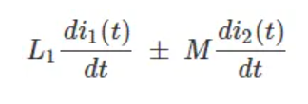

Mutual inductance
Now without disturbing the source at coil 2, we connect a time varying current source across the coil 1.
In that situation, there will be a self induced emf across the coil 1 due to its own current and also mutually induced emf across the coil 1 for the current in coil 2.
So the resultant emf induced in the coil 1 is
Mutually induced emf may be either additive or subtractive depending on the polarity of the coil. The expression of M is
Assuming tightly coupled coil with k=1

Slide 12
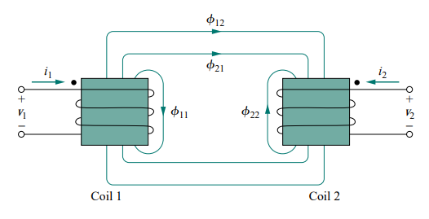
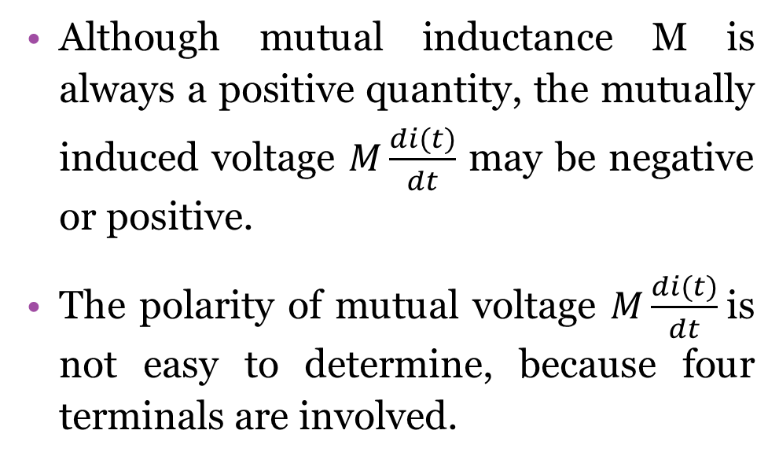
Dot convention
Although mutual inductance M is always a positive quantity, the mutually induced voltage $M\frac{di(t)}{dt}$ may be negative or positive.
The polarity of mutual voltage $M\frac{di(t)}{dt}$is not easy to determine, because four terminals are involved.

Slide 13
Dot convention
So, we apply the dot convention in circuit analysis.
By this convention, a dot is placed in the circuit at one end of each of the two magnetically coupled coils to indicate the direction of the magnetic flux if current enters that dotted terminal of the coil.

Slide 14
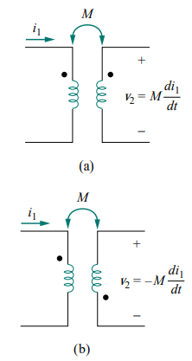
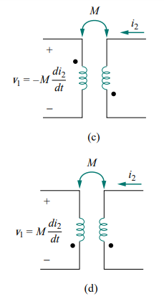
Dot convention
If the current enters at the dotted terminal of one coil, then it induces a voltage at another coil, which is having positive polarity at the dotted terminal.
If the current leaves from the dotted terminal of one coil, then it induces a voltage at another coil, which is having negative polarity at the dotted terminal.

Slide 15
Classification of Coupling
We can classify coupling into the following two categories.
Electrical Coupling (Dot convention for coils in series)
Magnetic Coupling

Slide 16
Electrical Coupling
Electrical coupling occurs, when there exists a physical connection between two coils (or inductors). This coupling can be of either aiding type or opposing type. It is based on whether the current enters at the dotted terminal or leaves from the dotted terminal.
Coupling of Aiding type
Coupling of Opposing type

Slide 17
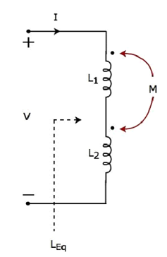
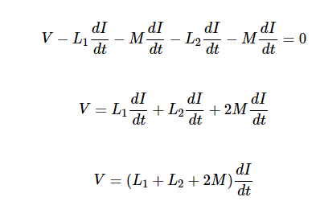
Coupling of Aiding type
Consider the following electric circuit, which is having two inductors that are connected in series.
Since the two inductors are connected in series, the same current I flow through both inductors having self-inductances L1 and L2.
In this case, the current, I enter at the dotted terminal of each inductor. Hence, the induced voltage in each inductor will be having positive polarity at the dotted terminal due to the current flowing in another coil.
Apply KVL around the loop of the above electric circuit or network

Slide 18
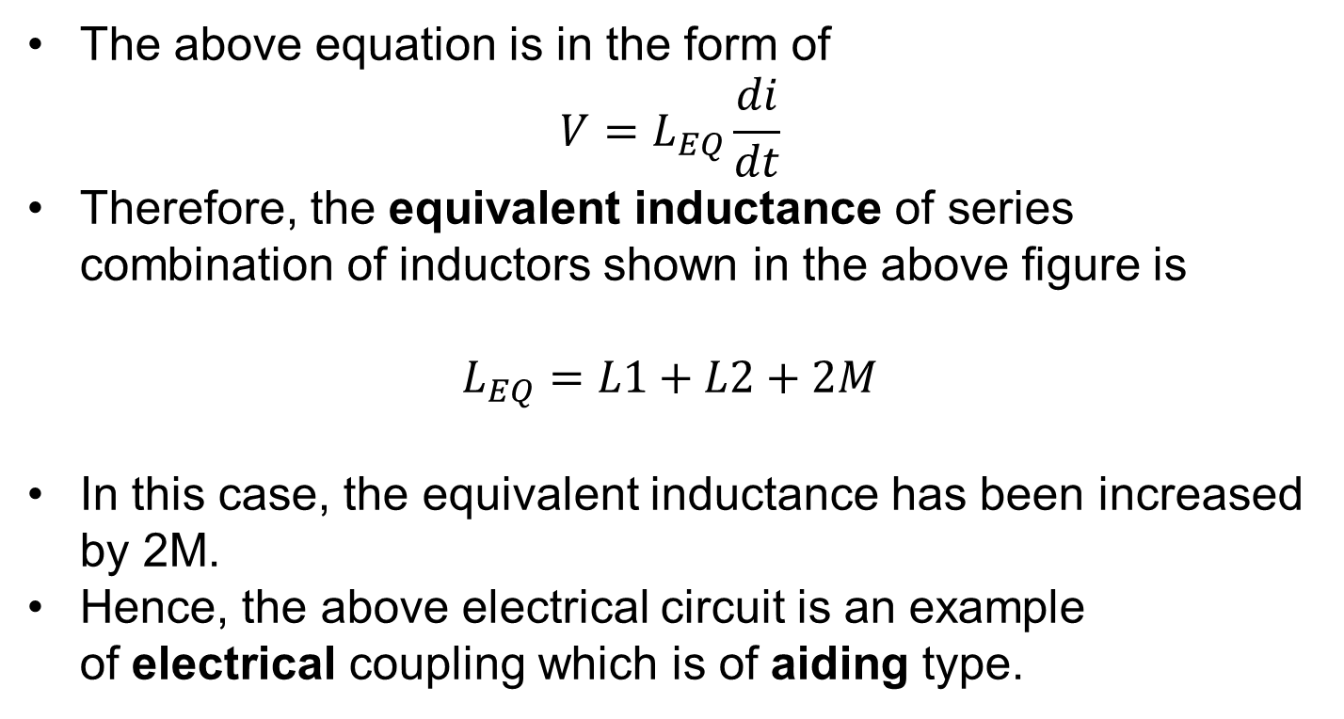
Coupling of Aiding type
The above equation is in the form of
$$V=L_{EQ}\frac{di}{dt}$$
Therefore, the equivalent inductance of series combination of inductors shown in the above figure is
$$L_{EQ}=L1+L2+2M$$
In this case, the equivalent inductance has been increased by 2M.
Hence, the above electrical circuit is an example of electrical coupling which is of aiding type.

Slide 19
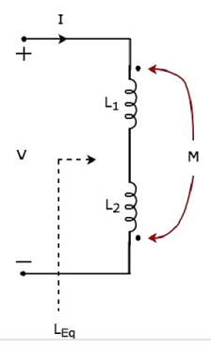
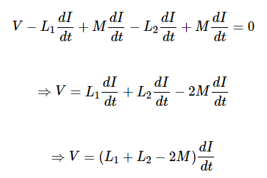
Coupling of opposing type
In this circuit, the current I enters at the dotted terminal of the inductor having an inductance of L1. Hence, it induces a voltage in the other inductor having an inductance of L2. So, positive polarity of the induced voltage is present at the dotted terminal of this inductor.
further, the current I leaves from the dotted terminal of the inductor having an inductance of L2. Hence, it induces a voltage in the other inductor having an inductance of L1. So, negative polarity of the induced voltage is present at the dotted terminal of this inductor.
Apply KVL around the loop of the above electric circuit or network.

Slide 20
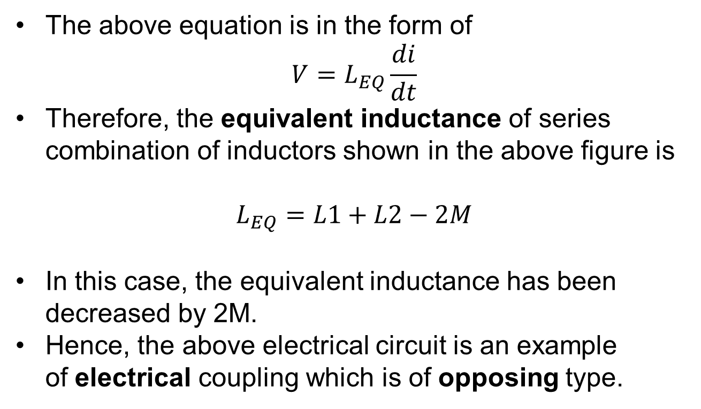
Coupling of opposing type
The above equation is in the form of
$$V=L_{EQ}\frac{di}{dt}$$
Therefore, the equivalent inductance of series combination of inductors shown in the above figure is
$$L_{EQ}=L1+L2−2M$$
In this case, the equivalent inductance has been decreased by 2M.
Hence, the above electrical circuit is an example of electrical coupling which is of opposing type.

Slide 21
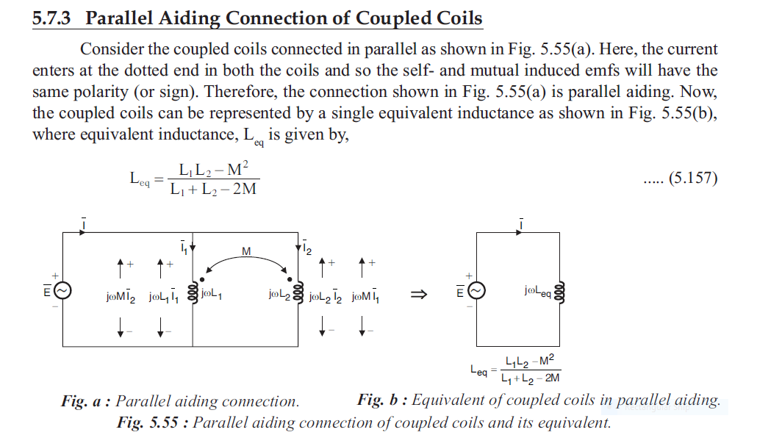

Slide 22
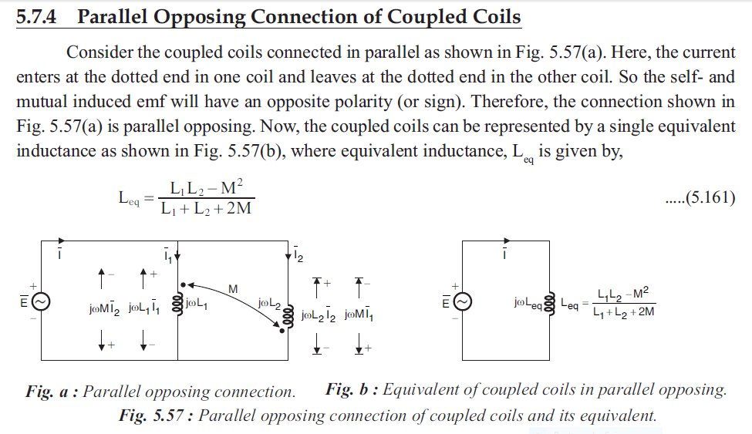

Slide 23
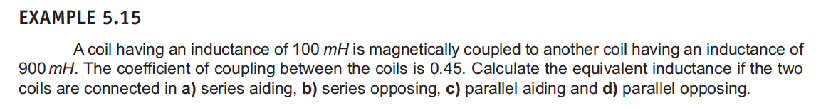
Question

Slide 24
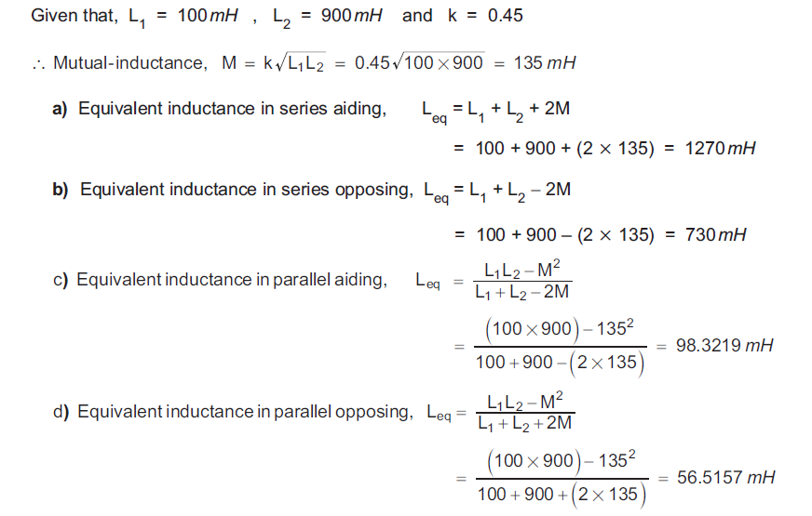
Question

Slide 25
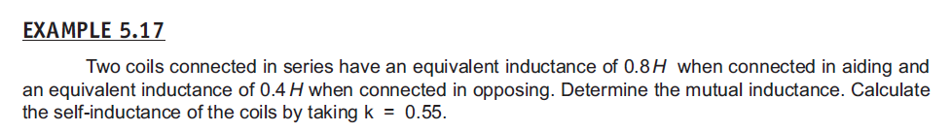
Question

Slide 26
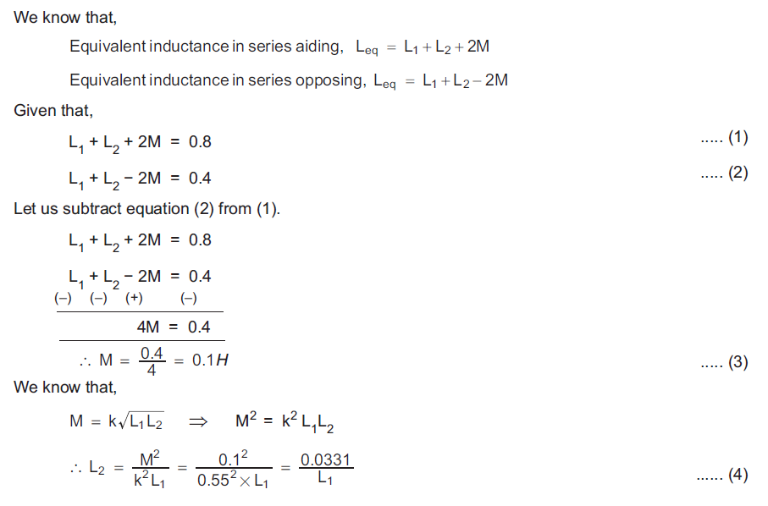
Question

Slide 27
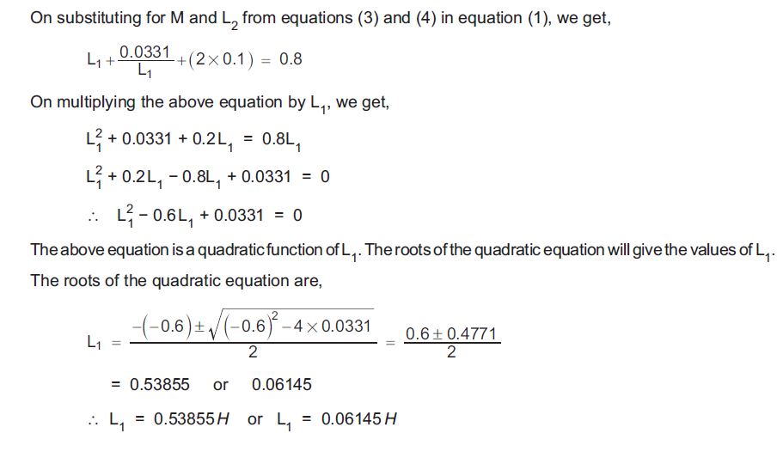

Slide 28
